Slide 1
Designing and Evaluating Universal Attack on Explainable AI
December 14, 2021
Chaewon (Emily) Park, Noah McDermott

Slide 2
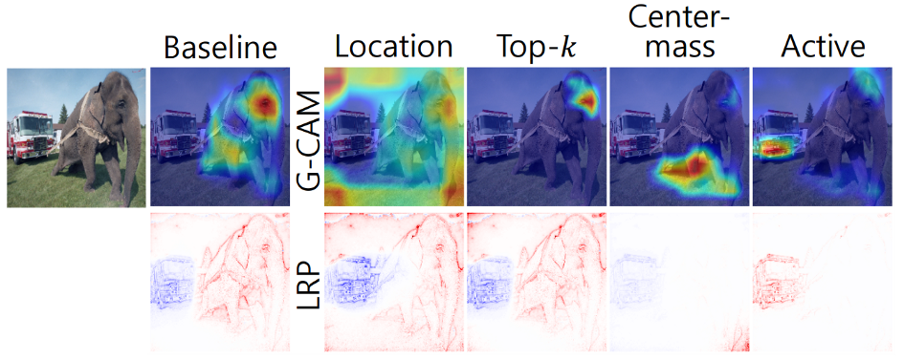
Motivation: Explainable AI - Significance & Vulnerability
Significance
Vulnerability
Significance
Valuable in domains that are safety-critical or require a high level of social acceptance
ex) medical diagnosis on patient CT scans, vision system for autonomous vehicles, loan approval support system
Explanations can be manipulated
Passive Fooling
Active Fooling
Vulnerability
Notes:
What problem are you trying to solve or look into? Why is it an important problem?

Slide 3
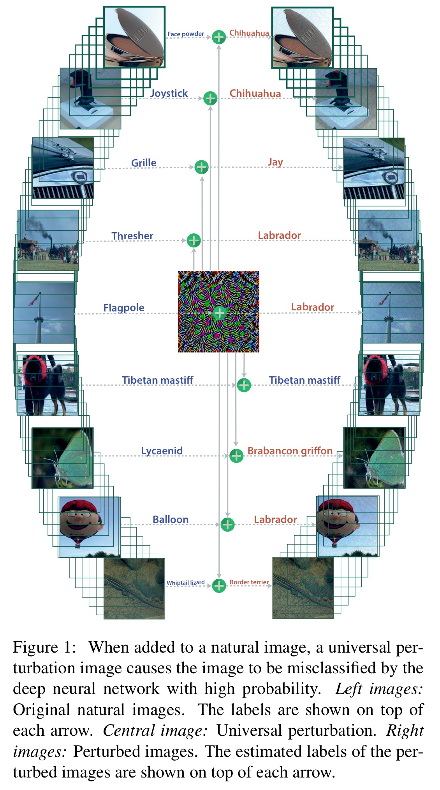
Universal Attack
Can one perturbation fool every class?
In 2017, the existence of universal attacks was proven
Approach: continually modify a single perturbation until it fools many images

Slide 4
Problem Statement
We explore the idea of leveraging Universal Attack to find a universal perturbation pattern that can be scaled across different classes to effectively and efficiently attack visual explanations

Slide 5
Pairwise Loss Motivation
How do we generate an adversarial attack on every explanation?
Gradient descent over not one but many images?
Only attack explanations, not classifiers
Loss function?
Inspired by Adversarial Logit Pairing
<Objective> “Maximize distance between the ‘clean’ and ‘perturbed’ explanation
AND
Minimize the cross entropy loss on label prediction”
<General Formulation> Loss = max(DIFF(CAM(img), CAM(img’))) + min(CE(y_img, y_img’)))

Slide 6
Pairwise Loss Implementations
EPS | Accuracy
12/255 | 0.275
5/255 | 0.59
3.5/255 | 0.745
Activations
L2 Norm
Activation
EPS | Accuracy
7/255 | 0.75
Dice Loss
Activation
Center Mass
EPS | Accuracy
9/255 | 0.73
Attention Map
EPS | Accuracy
12/255 | 0.75
L2 Norm
Attention Map
EPS | Accuracy
12/255 | 0.75
Dice Loss

Slide 7
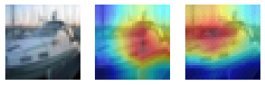
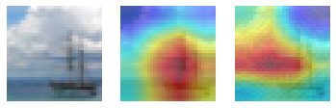

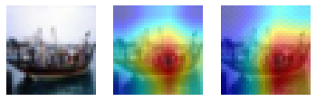
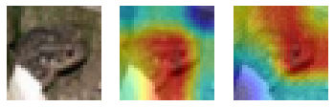
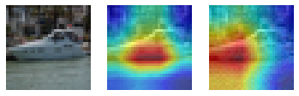
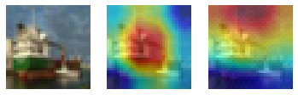
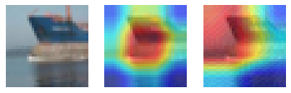
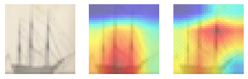
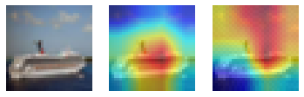
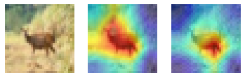
Experiment Results
Raw Activations
*L2 Norm: [Acc: 74.5%, Attack Success Metric (Dice): 0.59]
*Dice Loss: [Acc: 73%, Attack Success Metric (Dice): 0.56]
*Center Mass: [Acc: 73%, Attack Success Metric (Dice): 0.57]
Notes:
What have you found out? Present experimental results here. Make sure to both describe what you are measuring, and draw appropriate conclusions. (“Here is a table showing the improved adversarial robustness on ResNet. As you can see from the table, our fancy method is pretty darn effective at…”)

Slide 8
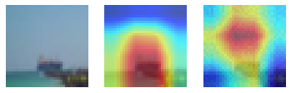
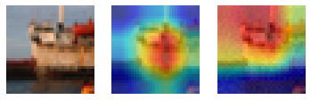
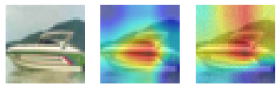
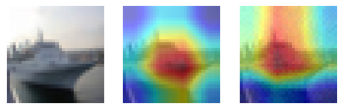
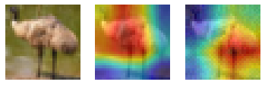
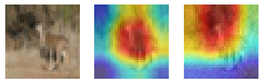
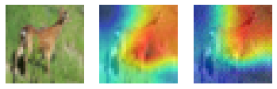
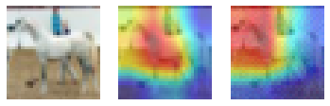
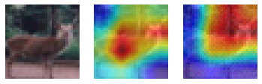
Experiment Results
*Dice Loss: [Acc: 75%, Attack Success Metric (Dice): 0.629]
Attention Map (EPS: 12/255)
*L2 Norm: [Acc: 73.4%, Attack Success Metric (Dice): 0.58]
Notes:
What have you found out? Present experimental results here. Make sure to both describe what you are measuring, and draw appropriate conclusions. (“Here is a table showing the improved adversarial robustness on ResNet. As you can see from the table, our fancy method is pretty darn effective at…”)

Slide 9
Conclusion
Universal attacks on visual explanation is possible
Two competing loss term with opposite goals
Attack on classification was easier: simply maximizing CE loss (single term)
Need to generalize over diverse inputs
so many pixels within an image, varying pixel intensities
a single universal pattern is a weak/insufficient tool
Visual Explanation is hard to assess
Manual assessment, dice loss
Heavy dependency on training data to generate universal pattern
CIFAR10: low resolution, single instance in center -> interfer UAP learning?
Next Steps: Narrow down scope to Class-Discriminative UAPs, ImageNet
Notes:
What did you learn from the process? What should others take away from what you did? Both specific (“Our method improved adversarial robustness by 5% on…”) and general (“Neural networks are incredibly fragile…”) conclusions. Note that conclusions are different than a summary – a summary is what you did, whereas conclusions are what you learned.

Slide 10
APPENDIX

Slide 11
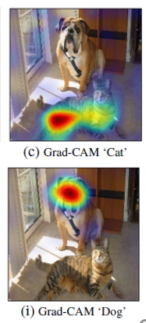
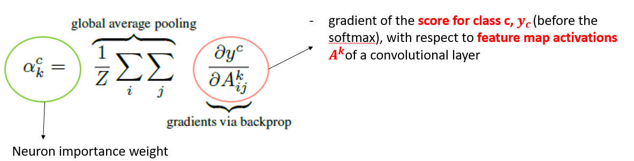
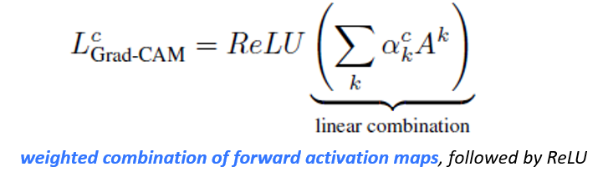
Attack on GradCAM (Gradient-based CAM)
ResNet18 backbone model + CIFAR10 dataset
Uses gradients flowing into the last convolutional layer to assign importance values to each neuron for a particular decision of interest

Slide 12
Overview
Introduction
Motivation: Explainable AI - Significance & Vulnerability
Universal Attack
Problem Statement
Approach
Pairwise Loss & Various Implementations
Results
Conclusion

